Slide 1
Pre-Calc & trig
Day 66

Slide 2
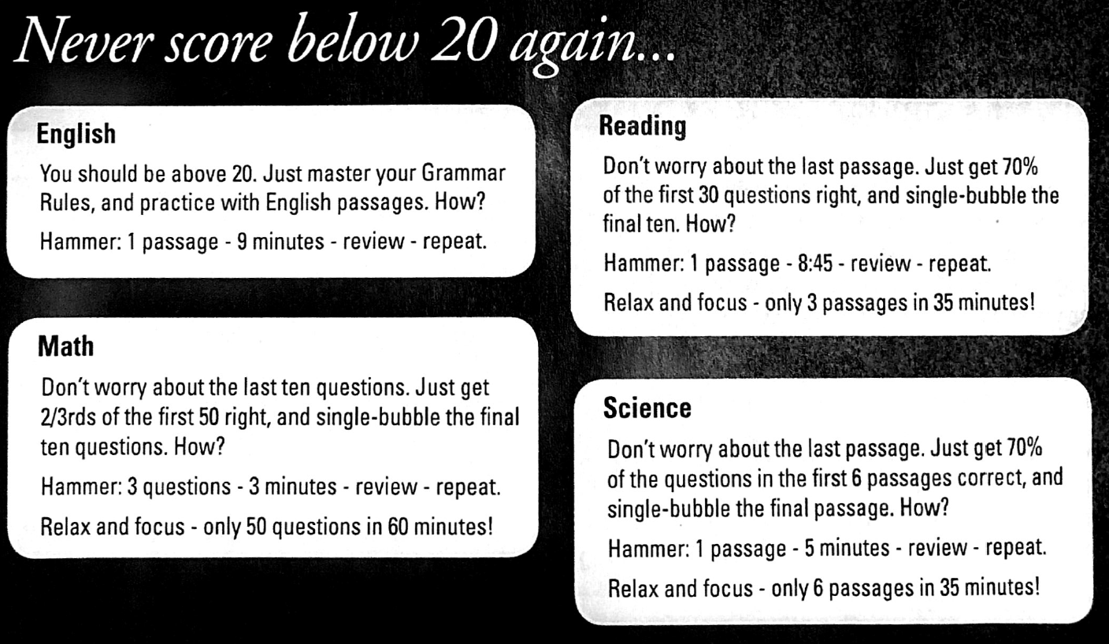

Slide 3
11.6 Analyzing Data
Objective: To calculate measures of central tendency
To draw and interpret box-and-whisker plots
Measures of Central Tendency: “middle” of the data set

Slide 4
Mean: the average of a set of data Median: when listed in order the middle number (if there is an even amount of data values then you take the mean of the “two middle” numbers to find the median) Mode: the most frequently occurring value(s)
*These are the three most common measures of central tendancy
Outlier: value that is substantially different from the rest of the data in the set *an outlier greatly influences the mean
Range: the difference between the greatest and least values

Slide 5
Find the mean, median, mode, range and outlier of the following data. How would the mean median and mode be affected if the outlier were removed?
51, 84, 88, 88, 90, 90, 90, 95, 98, 99, 100

Slide 6
Find the mean, median, mode, range and outlier of the following data. How would the mean median and mode be affected if the outlier were removed?
51, 84, 88, 88, 90, 90, 90, 95, 98, 99, 100
With Outlier Without Outlier
Mean: 973/11=88.45 Mean: 922/10=92.2 Median: 90 Median: 90 Mode: 90 Mode: 90 Outlier: 51 Outlier: ignored
Range: 49

Slide 7
Quartiles: what is created when you use the median to split the data into two parts, then split the two parts into two again using the median of each
Interquartile Range: difference between the 1st and 3rd quartile
Box-and-whisker plot: a way to display data using quartiles, minimums and maximums

Slide 8
Example: 51, 84, 88, 88, 90, 90, 90, 95, 98, 99, 100 Use the data above to create a box-and-whisker plot.

Slide 9
Example: 51, 84, 88, 88, 90, 90, 90, 95, 98, 99, 100
51, 84, 88, 88, 90, 90, 90, 95, 98, 99, 100
Minimum------[Q1 Median Q3]----------Maximum
Q1=88
Q2=median=90
Q3=98
The interquartile range is 98-88=10

Slide 10
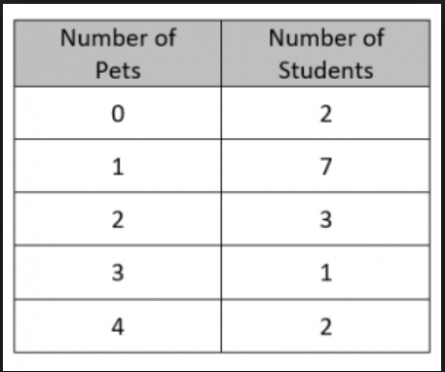
Frequency Chart
Find the mean, median, mode, range and outlier of the following data

Slide 11
For Next Time
Page 715 #1-3, 5-9, 11-13

